Slide 1

Creating Dashboard using VGA (Visualization for Geospatial Analysis) Framework
CMPT 384 – Information Visualization
Course Instructor: Debajyoti Mondal
Lab Tutorial Instructor : Arman Heydari( arman.heydari@usask.ca )

Slide 2
What is VGA?
A framework built to combine visualizations and data processing avoiding the effort of building visualization dashboard from scratch
You can grab visualizations built in d3 (and others) and create a plugin around them
You can write some data processing code and create a plugin based on that
You can use those plugins to create visualization dashboard
The vga framework will create visualizations simply as .json files
We will now go through some tasks – Use a good code editor to make the coding easier --- you can use basic editor such as notepad++ that highlights the tags, or more advanced editors such as visual studio code

Slide 3
Start the server
Microsoft Windows [Version 10.0.15063]
(c) 2017 Microsoft Corporation. All rights reserved.
C:\> python -m SimpleHTTPServer 8888
C:\Users\jyoti\AppData\Local\Programs\Python\Python37-32\python.exe: No module named SimpleHTTPServer
C:\> python -m http.server 8888
Serving HTTP on 0.0.0.0 port 8888 (http://0.0.0.0:8888/) ...

Slide 4
TASK 1

Slide 5
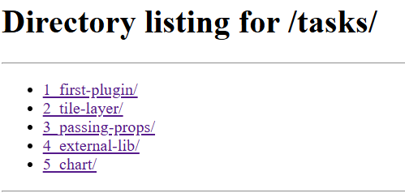
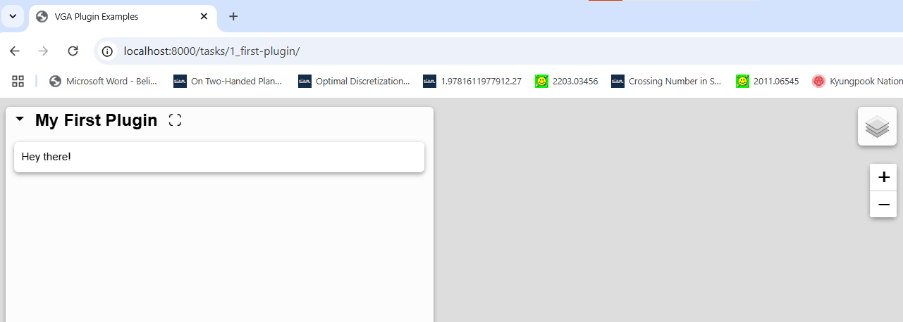
Creating Visualization Dashboard
Navigate to 1_first-plugin/
This will show up an empty map dashboard
with some text ‘Hey there!’

Slide 6
Creating Visualization Dashboard
This is being created by creating
a .json file and passing it to the
vga framework

Slide 7
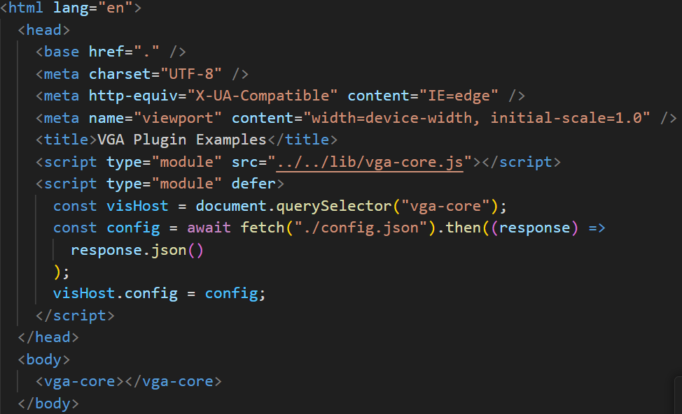
Understanding the code
1_first-plugin/index.html
Import the vga library
Create an instance of vga
try to fetch the config file over the local server
Pass the config (.json) file to vga
The vga library will write the code here for you

Slide 8
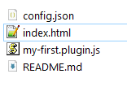
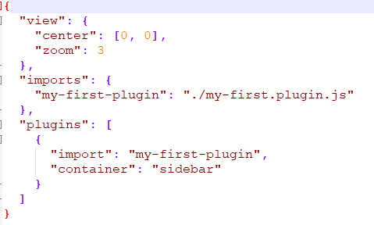
Understanding the code
1_first-plugin/index.html
Where is this config file?
Import the vga library
Create an instance of vga
try to fetch the config file over the local server
Pass the config (.json) file to vga
The vga library will write the code here for you

Slide 9
Understanding the code
1_first-plugin/index.html
Where is this config file?
Import the vga library
What should we do?
Understand the functions of .js
Understand .json
Understand the changes in dashboard once you change .js or .json
Create an instance of vga
try to fetch the config file over the local server
Pass the config (.json) file to vga
The vga library will write the code here for you

Slide 10
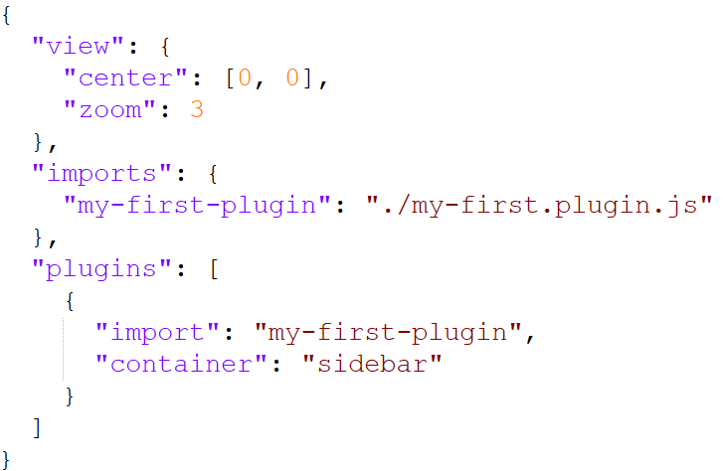
Understanding the code
These are map properties. You can change this to [56,-106] for centering the map on Canada but nothing will change as a map is not currently loaded
config.json
This is the way of importing the .js plugin.
What you define when you are importing .js should be the same here.
What you define when you are importing .js should be the same here.
Whatever you render in plugin, should be visualized in “sidebar”. There are two other options "hidden" or "main“ that would come up later. Change and see what happens.
The text in purple are vga tags and this should not be changed (except for the string that you define when importing .js)
If changes in viz does not show up after you change something in the plugin, then remember to hard reload, or disable cache. Check the code changes in dev mode.

Slide 11
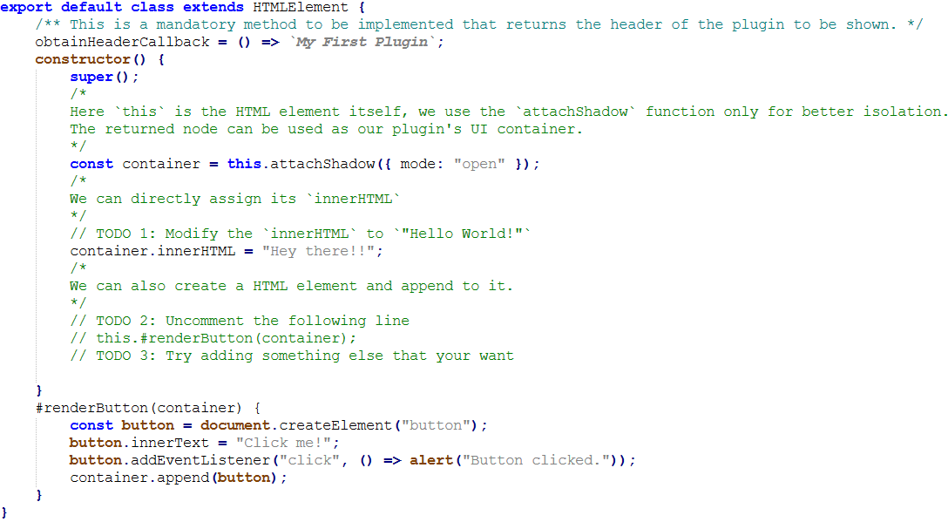
The Plugin .js code
Assume all these to be default to create a container where everything of this plugin will be rendered.
Whatever you write here should show up in the sidebar (assuming your .json file mentions “sidebar”)
You can write a javascript function and call it here. Whatever you render will show up in the sidebar
But how do I write this code? I only know d3 and very basics of javascript.
If changes in viz does not show up after you change something in the plugin, then remember to hard reload, or disable cache. Check the code changes in dev mode.

Slide 12
The Plugin .js code
Assume all these to be default to create a container where everything of this plugin will be rendered.
Whatever you write here should show up in the sidebar (assuming your .json file mentions “sidebar”)
You can write a javascript function and call it here. Whatever you render will show up in the sidebar
If you want to write a d3 function to create circles, this will NOT work yet but we will show how to do it
var svg = d3.select("body").append("svg").attr("width", 200).attr("height", 200); svg.append('circle').attr('cx', 100).attr('cy', 100).attr('r', 50).attr('stroke', 'black’);

Slide 13
TASK 2

Slide 14
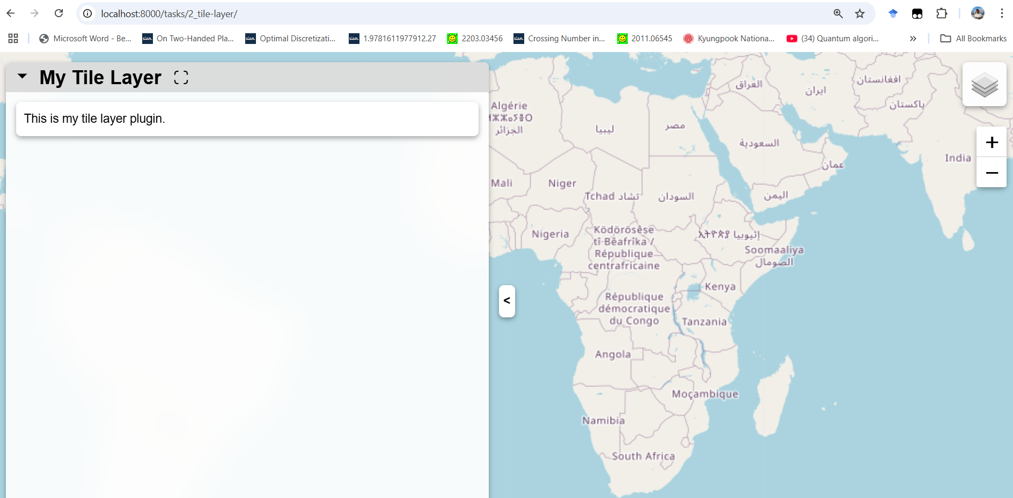
The html and .json files are the same as TASK1. The only change is in the .js file
Navigate to 2_tile-layer/ and edit the .js file as follows.
// TODO 1: Uncomment the following line this.#createAndAddATileLayerIntoMap();
This will show up a map
If changes in viz does not show up after you change something in the plugin, then remember to hard reload, or disable cache. Check the code changes in dev mode.

Slide 15
Understanding the code
These are map properties. You now can change this to [56,-106] for centering the map on Canada. You can also change this to other [lat, long]
https://dwtkns.com/pointplotter/
You can also try to change zoom – typically between 1 to 12
config.json
If changes in viz does not show up after you change something in the plugin, then remember to hard reload, or disable cache. Check the code changes in dev mode.

Slide 16
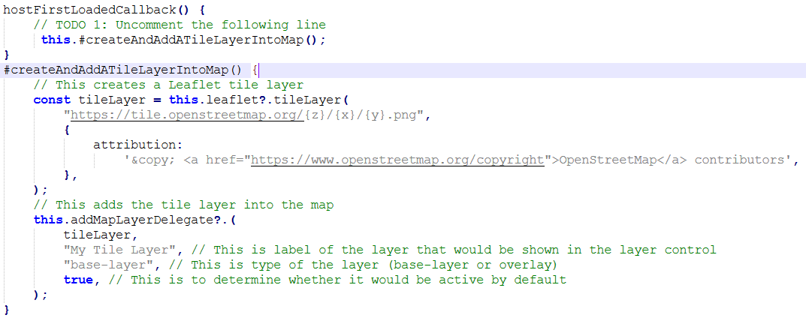
Task2: Plugin .js code
There is a popular map rendering library called leaflet
VGA is built on top of leaflet and you can access all functionalities of leaflet by using this.leaflet
Here we use the leaflet to create the map
OpenStreetMap is a free, open map database updated and maintained by a community of volunteers via open collaboration, which can be accessed in this link. We also add proper attribution.
You can use the addMapLayerDelegate function to add the map and you can specify the location using three parameters: title, type of layer, active or not
Change to overlay and see that on the top right corner you will have a checkbox to select the layer
Making this false avoids rendering the layer unless selected by user
If changes in viz does not show up after you change something in the plugin, then remember to hard reload, or disable cache. Check the code changes in dev mode.

Slide 17
TASK 3

Slide 18
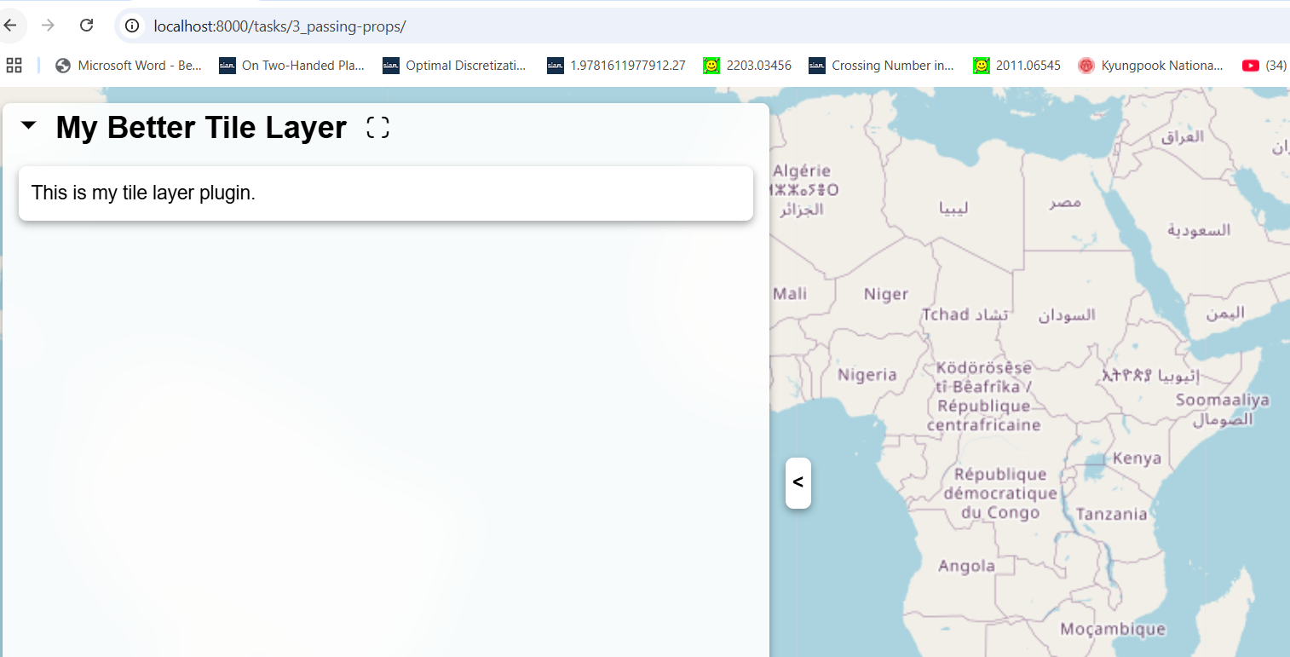
This task shows how you can specify properties in .json file and access them in .js file Navigate to 3_passing-props/ The output will be the same as Task 2
If changes in viz does not show up after you change something in the plugin, then remember to hard reload, or disable cache. Check the code changes in dev mode.

Slide 19
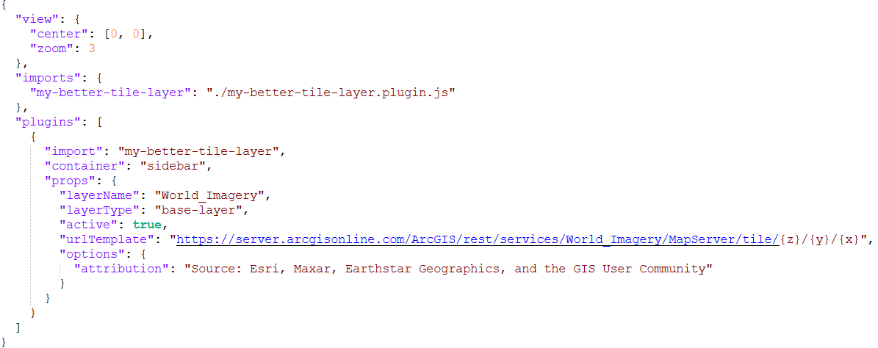
We now provide all properties in .json file and use them in .js file as needed
You can also use
"World_Physical_Map", "NatGeo_World_Map", "World_Street_Map“
This time we are using map provided by arcgis
If changes in viz does not show up after you change something in the plugin, then remember to hard reload, or disable cache. Check the code changes in dev mode.

Slide 20
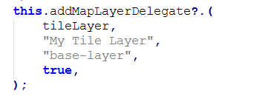
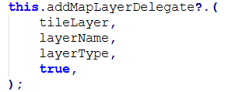
We now provide all properties in .json file and use them in .js file as needed
Previous plugin .js
New plugin .js
.json file
If changes in viz does not show up after you change something in the plugin, then remember to hard reload, or disable cache. Check the code changes in dev mode.

Slide 21
TASK 4

Slide 22
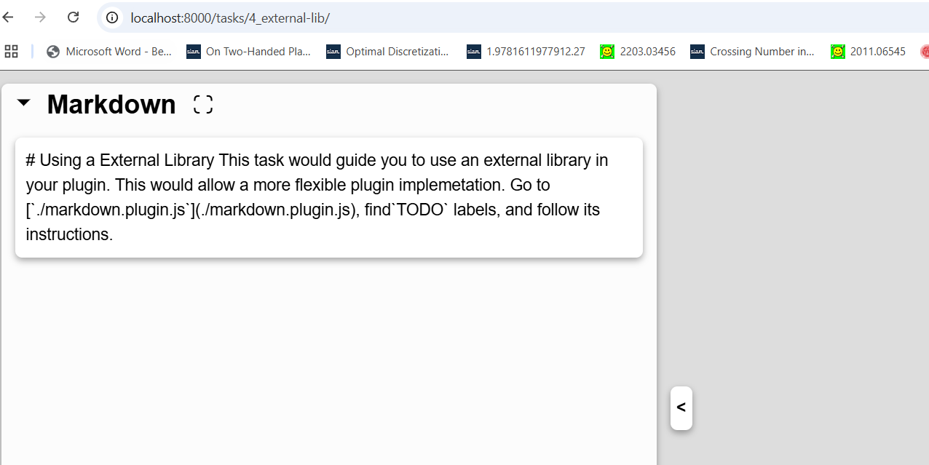
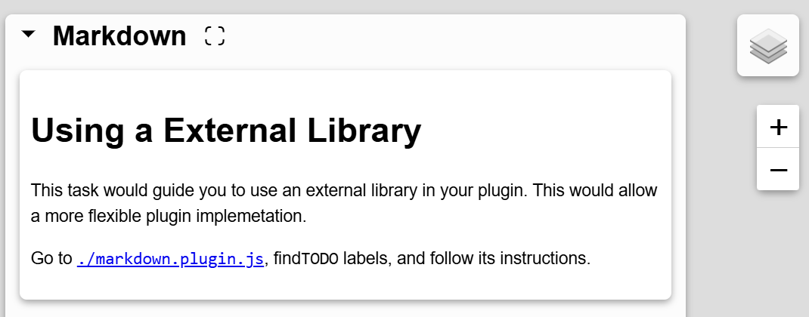
VGA helps to integrate external library. Here we incorporating an external text parsing library Navigate to 4_external-lib/ The output will show a long text
https://www.npmjs.com/package/marked
We will pass the text to the parser library to get
If changes in viz does not show up after you change something in the plugin, then remember to hard reload, or disable cache. Check the code changes in dev mode.

Slide 23
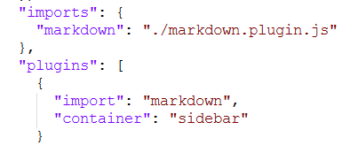
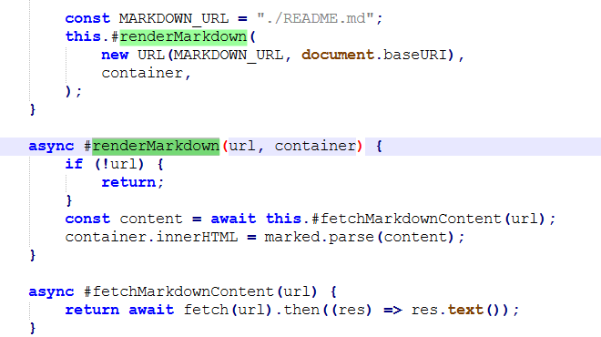
We have already specified our .js file plugin in the .json file Let’s now examine the plugin .js file
Importing the external library
We have written a javascript function that will read a file from the url specified and render the content in help container
Here we are fetching the file from the server
Here we are using the marked.parse function provided by the parser to reformat the content
If changes in viz does not show up after you change something in the plugin, then remember to hard reload, or disable cache. Check the code changes in dev mode.

Slide 24
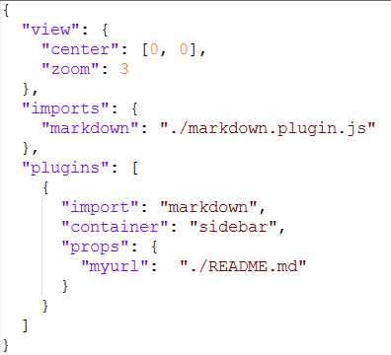

Instead of hard-coding the file path in the plugin code, you can specify it in the .json file and access the property in .js file
If changes in viz does not show up after you change something in the plugin, then remember to hard reload, or disable cache. Check the code changes in dev mode.

Slide 25
TASK 5

Slide 26
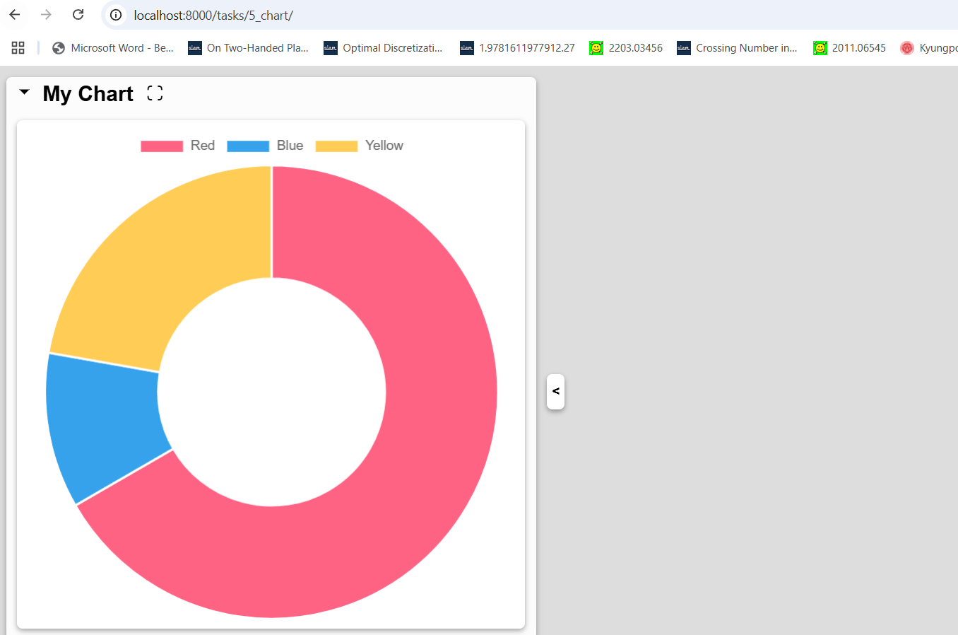
Navigate to 5_chart The output will show a chart
VGA helps to integrate external library. Here we incorporating an external chart building library
https://www.chartjs.org/docs/
If changes in viz does not show up after you change something in the plugin, then remember to hard reload, or disable cache. Check the code changes in dev mode.

Slide 27
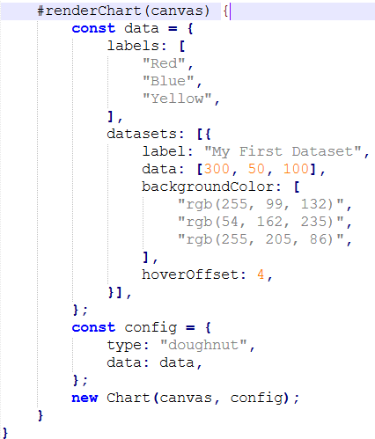
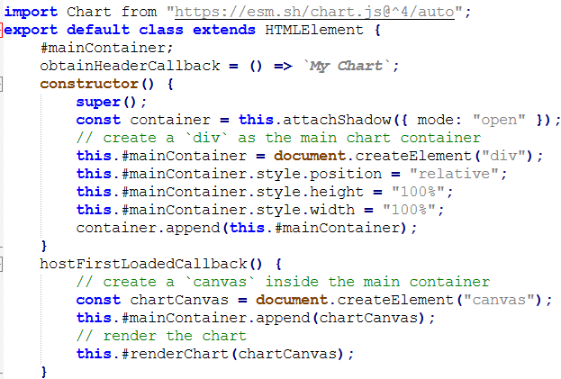
First import the chart library
Create a <div> and append it to the html container
Append a canvas to the <div>
Render a chart using the imported lib
A code created following the external chart library specification
If changes in viz does not show up after you change something in the plugin, then remember to hard reload, or disable cache. Check the code changes in dev mode.

Slide 28
TASK 6

Slide 29
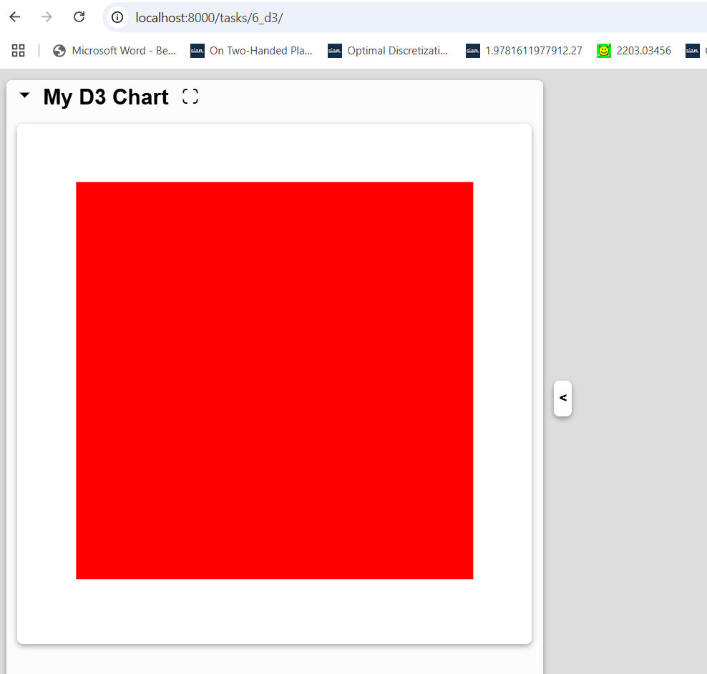
Navigate to 6_d3 The output will be a rectangle drawn using d3
VGA helps to integrate external library. Here we incorporating an external d3 library
If changes in viz does not show up after you change something in the plugin, then remember to hard reload, or disable cache. Check the code changes in dev mode.

Slide 30
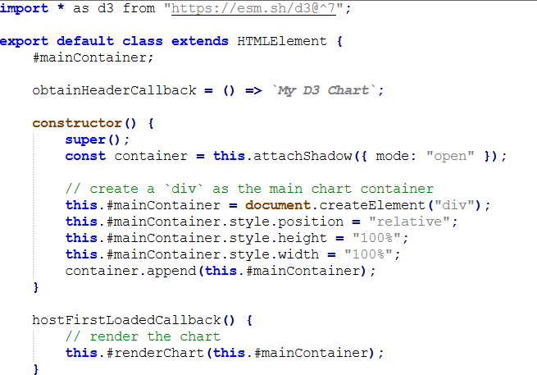
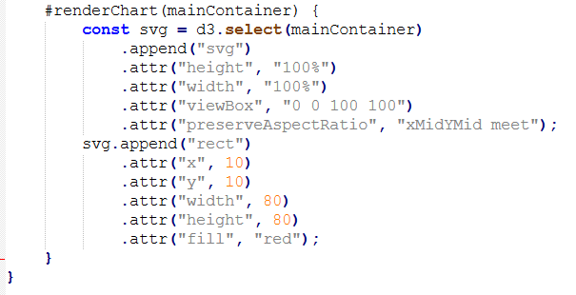
First import the chart library
Create a <div> and append it to the html container
Append a canvas to the <div>
Render a chart using the imported lib
A code created following the d3 library specification
If changes in viz does not show up after you change something in the plugin, then remember to hard reload, or disable cache. Check the code changes in dev mode.

